Slide 1
SA420-NATURAL RESOURCE ECONOMICS
LECTURER NAME:
MULENGA MPOLOKOSO
(Ph.D_WIP, MBA, BBA, BICTED, BSCFO, TM, ISP, CMP)

Slide 2
TOPIC 1: BASIC PRINCIPLES OF MICRO ECONOMICS
TOPIC OUTLINE:
GRAPHIC AND MATHEMATICAL REPRESENTATION OF DEMAND AND SUPPLY
FACTORS SHIFTING DEMAND AND SUPPLY
MARKET EQUILIBRIUM
SURPLUS
SHORTAGE
PRICE AND CROSS PRICE ELASTICITIES OF DEMAND AND SUPPLY

Slide 3
GRAPHIC AND MATHEMATICAL REPRESENTATION OF DEMAND AND SUPPLY
In general, Demand means desire by human.
In economics, Demand refers to the desire backed by ability to pay and willingness to buy it.
A beggar may desire to have a car, but his desire is not going to affect its market price as he is not having the necessary purchasing power to buy a car.
Thus, desire backed by purchasing power is called demand.

Slide 4
KINDS OF DEMAND
I. Direct Demand: It refers to demand for a commodity that is directly consumed to satisfy human wants, for example demand for bread, butter and fruits.
a) Price Demand: it refers to the demand for a commodity at a particular price
b) Income Demand: It refers to the demand for a commodity at a various levels of consumer’s income
c) Cross Demand: It refers to quantity demanded of a commodity due to change in the price of other commodity
II. Indirect Demand or Derived Demand:
Demand for factors of production is indirect because they help in the production of a commodity which is directly demanded by the consumer in the market.
III. Complementary Demand/ Joint Demand:
It refers to the demand for those goods for a commodity which are always demanded jointly. Example: car and petrol.
IV. Composite Demand:
It refers to the total demand for a commodity which can be used for various purposes.

Slide 5
LAW OF DEMAND – ALFRED MARSHALL
Definition: The law of demand states that , other things remaining equal,
The quantity demanded for a commodity increases when its price falls and
Decreases when the price rises.
There is a inverse relationship between the price of the good and the quantity demanded of that good.

Slide 6
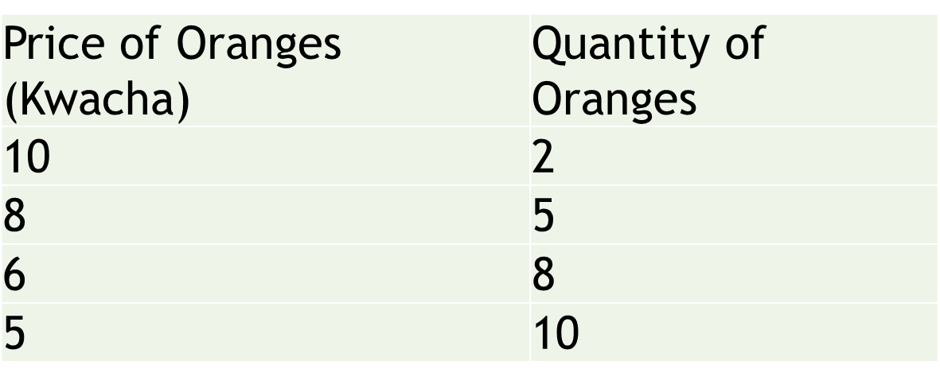
ASSUMPTIONS OF THE LAW OF DEMAND
The price of the related goods remains the same
The income of the consumers remain unchanged
Tastes and preferences of the consumer remain the same
DEMAND SCHEDULE FOR ORANGE

Slide 7
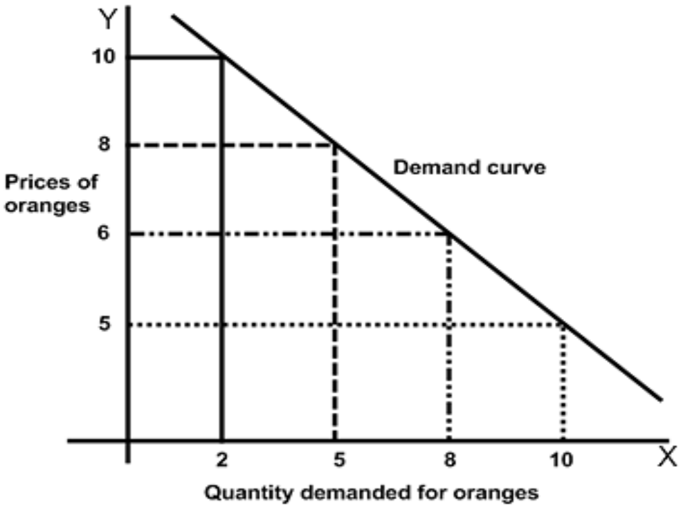
DEMAND CURVE

Slide 8
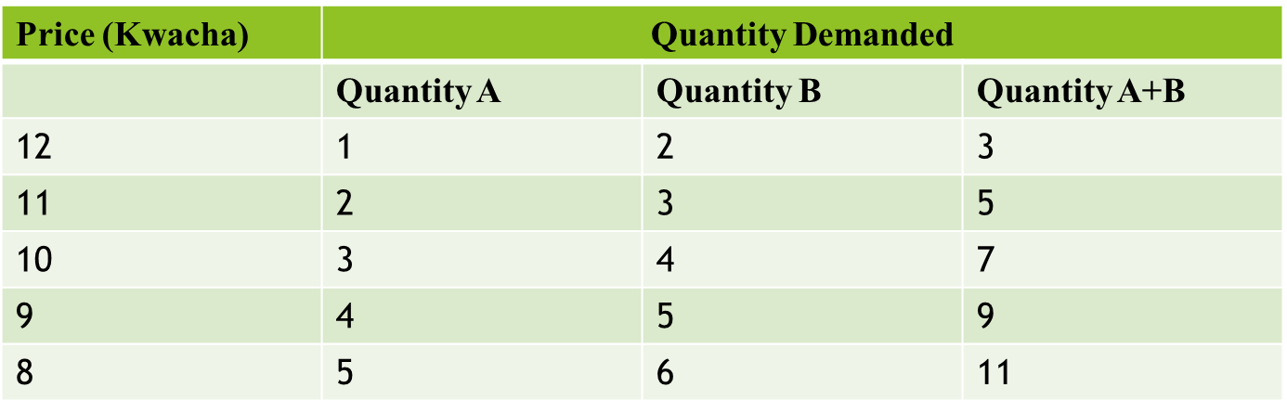
MARKET DEMAND SCHEDULE
A demand schedule for a market can be constructed by adding up demand schedules of the individual consumers in the market.
Suppose that the market for Apple consists of 2 consumers. The market demand is calculated as follows.

Slide 9
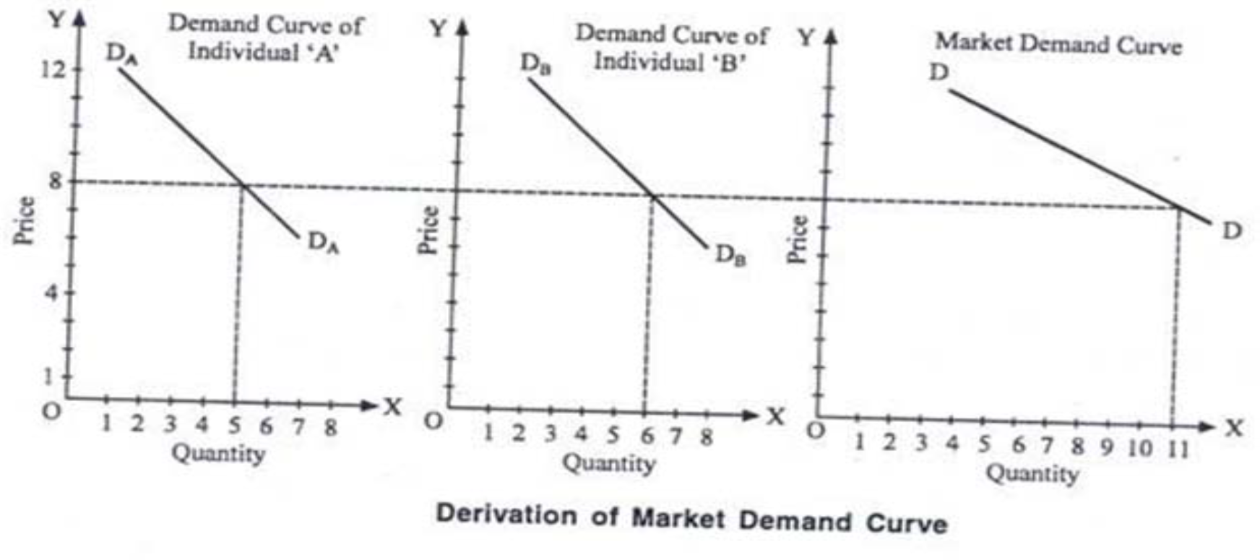
DERIVATION OF MARKET DEMAND CURVE

Slide 10
REASONS BEHIND DOWNWARD SLOPE OF THE DEMAND CURVE
1. Law of diminishing marginal utility: The law of demand is based on the law of diminishing marginal utility which states that as the consumer purchases more and more units of a commodity,
The utility derived from such successive unit goes on decreasing.
Like that, consumer purchases more of the commodity so that his marginal utility from the commodity falls to be equal to the reduced price and vice‐ versa.
2. Substitution Effect: The substitution effect is the effect that a change in relative prices of substitute goods changes the quantity demanded.
When the price of a good rises the consumer prefers to buy its substitute goods which have became relatively cheaper.

Slide 11
CONT…
3. Income Effect: Change in demand on account of change in real income resulting from change in the price of a commodity is known as income effect.
4. Several Uses. Some commodities can be put to several uses which lead to downward slope of the demand curve.
When the price of such commodities goes up they will be used for important purposes, so their demand will be limited.
Choices :Scarcity refers to the finite nature and availability of resources while choice refers to people's decisions about sharing and using those resources. The problem of scarcity and choice lies at the very heart of economics, which is the study of how individuals and society choose to allocate scarce resources.
Opportunity Cost : This concept of scarcity leads to the idea of opportunity cost. Opportunity cost is the cost of next best alternative foregone or the value of the best alternative forgone in making any choice
Rationality: Rational behavior is the cornerstone of rational choice theory, a theory of economics that assumes that individuals always make decisions that provide them with the highest amount of personal utility. These decisions provide people with the greatest benefit or satisfaction given the choices available

Slide 12
EXCEPTIONS TO THE LAW OF DEMAND
The Law of demand is a general statement telling that prices and quantities of a commodity are inversely related.
There are certain peculiar cases in which the law of demand will not hold good.
I. Veblen Effect: Veblen has pointed out that there are some goods demanded by very rich people for their social prestige.
When price of such goods rise, their use becomes more attractive and they are purchased in larger quantities.
Demand for diamonds from the richer class will go up if there is increase in price. If such goods were cheaper, the rich would not even purchase.

Slide 13
CONT…
II. Giffen Paradox : Sir Robert Giffen discovered that the poor people will,
Demand more of inferior goods if their prices rise and
Demand less if their prices fall.
For example, poor people spend the major part of their income on coarse grains (e.g. Maize ) and only a small part on rice.

Slide 14
MOVEMENT IN DEMAND CURVE OR EXPANSION AND CONTRACTION OF DEMAND
A movement along the demand curve is caused by a change in the price of the goods only other things remaining constant.
I. Expansion of Demand:
It refers to rise in demand due to fall in the price of the goods.
II. Contraction of Demand:
It refers to fall in demand due to rise in the price of goods.

Slide 15
MOVEMENT IN DEMAND CURVE OR EXPANSION AND CONTRACTION OF DEMAND
Expansion in demand: A fall in price from K16 to K12 leads to an expansion (increase) in demand. As price falls, there is a movement along the demand curve and more is bought.
Contraction in demand: An increase in price from K12 to K16 causes a movement along the demand curve, and quantity demand falls from 80 to 60. We say this is a contraction in demand

Slide 16
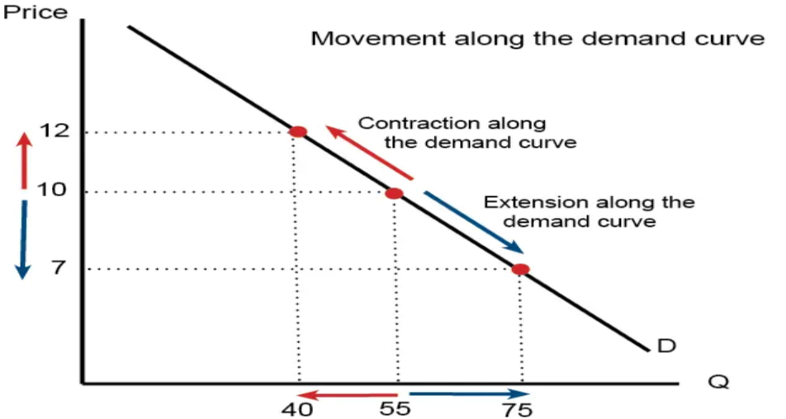
MOVEMENT IN DEMAND CURVE OR EXPANSION AND CONTRACTION OF DEMAND

Slide 17
SHIFTS IN DEMAND OR INCREASE AND DECREASE IN DEMAND
The shift of the demand curve is caused by changes in factors other than price of goods. These factors are
A) Consumer’s income
B) Price of relative or substitute goods
C) Consumer’s taste and preferences
I. Increase in Demand:
It refers to the situation when the consumers buy a large amount of commodity at the same price.
The reasons are;
Increases in the income of consumer
Increase in the price of substitute goods
Expectation of rise in price in future
Increase in population

Slide 18
II. Decrease in Demand:
It refers to a situation when the consumers buy a smaller quantity of thee commodity at the same price.
The reasons are;
Fall in the income of thee consumers
Fall in the price of the substitute goods
Expectation of fall in price
Decrease in Population
Consumers’ taste becoming unfavorable towards the goods

Slide 19
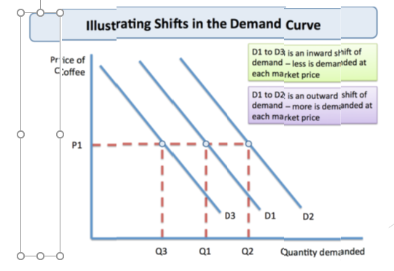
SHIFTTS IN DEMMAND OR IINCREASEE AND DECREASE IIN DEMANND

Slide 20
LAW OF SUPPLY
The relationship between price and quantity supplied is usually a positive relationship. A rise in price is associated with a rise in quantity supplied.
Definitions
Dooley says "The law of supply states that other things being equal the higher the price, the greater the quantity supplied or the lower the price, the smaller the quantity supplied.“
Lipsey, defines it as "The law of supply states that other things being equal, the quantity of any commodity that firms will produce and offer for sale is positively related to the commodity's own price, rising when price rises and falling when price falls.“
As the price of good increases, suppliers will attempt to maximize profits by increasing the quantity of the product sold.

Slide 21
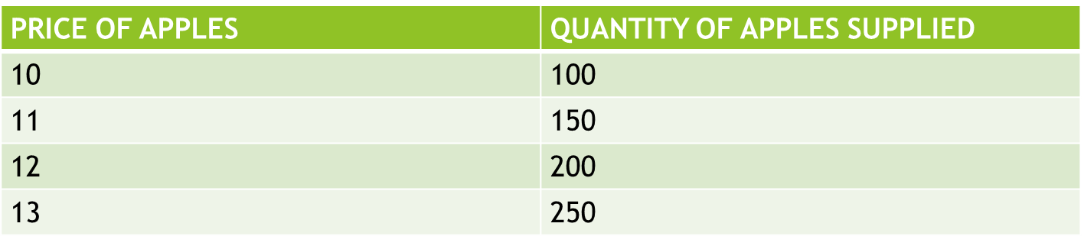
SUPPLY SCHEDULE

Slide 22
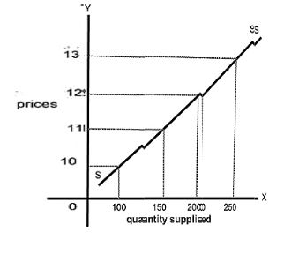
SUPPLY CURVE

Slide 23
DETERMINANTS OF SUPPLY
Cost of factors of production
Price of raw materials
Rent and interest on Machinery
Cost of Machinery
Payments on Human Resources (wages & Salaries)
Payments on Transport
If Production is high Supply will be low

Slide 24
Movement along the Supply Curve
A change in price causes a movement along the supply curve; such a movement is called a change in quantity supplied.
As is the case with a change in quantity demanded, a change in quantity supplied does not shift the supply curve. By definition, it is a movement along the supply curve.
For example, if the price rises from P1 to P3, the quantity supplied rises from Q1 to Q3 and that is an expansion in supply.
When the price drops from P1 to P2, the quantity supplied drops from Q1 to Q2 and that is a contraction in supply.

Slide 25
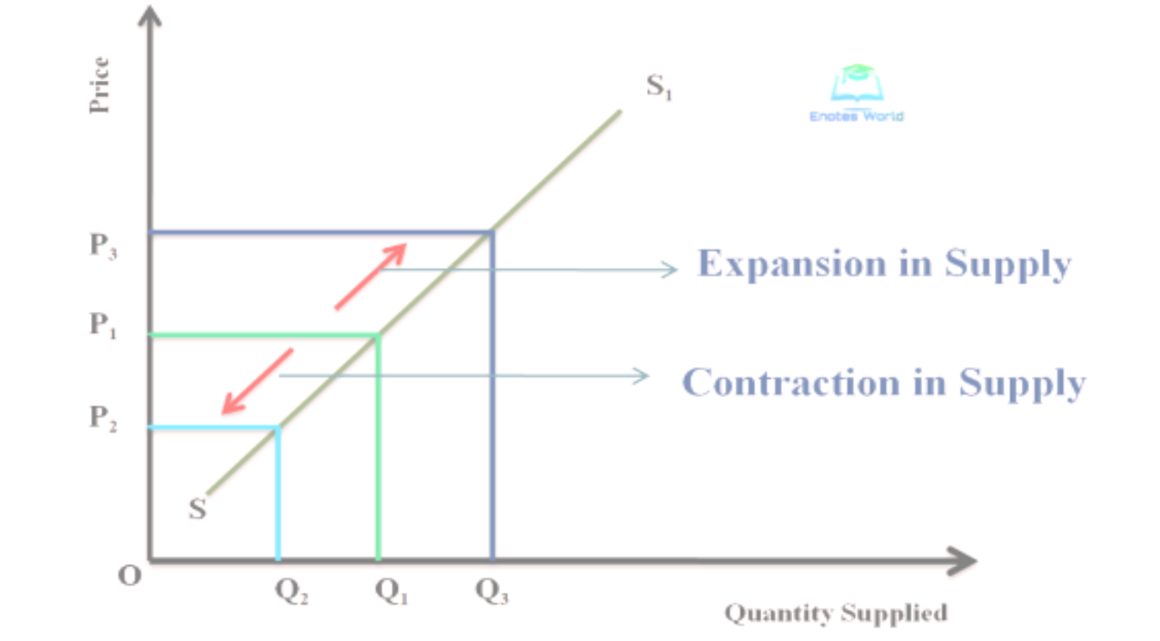
SUPPLY CURVE

Slide 26
Shifts in the Supply Curve
Shifts in supply curve arise from changes in the following
The cost of production for the firms:
For example, autoworkers in Zambia represented by a union might negotiate a new labour contract for higher wages.
This represents a cost increase on the part of firms and will result in a leftward shift of the supply curve.
Technology that affects the production function:
For example, a new robotic technology that aids in the assembly of automobiles in the factory could improve the efficiency of the plant, resulting in a rightward shift of the supply curve.

Slide 27
SHIFTS IN SUPPLY CURVE
The number of sellers in the market:
For example, perhaps a new company, like Toyota decides to begin to manufacture cars in Zambia, the number of sellers has increased, and the number of cars for sale is likely to increase as well, leading to a rightward shift in the supply curve.
• The presence of alternative markets for sellers:
For example, an economic boom in Zambia might cause South African manufacturers to send more of the cars they produce to Zambia instead of selling them in South African, leading to a lower supply of cars in the South African market represented by a leftward shift in the supply curve.

Slide 28
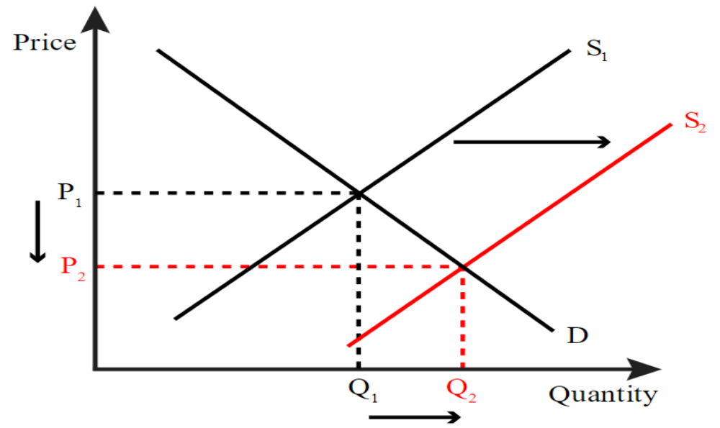
Increase in Supply

Slide 29
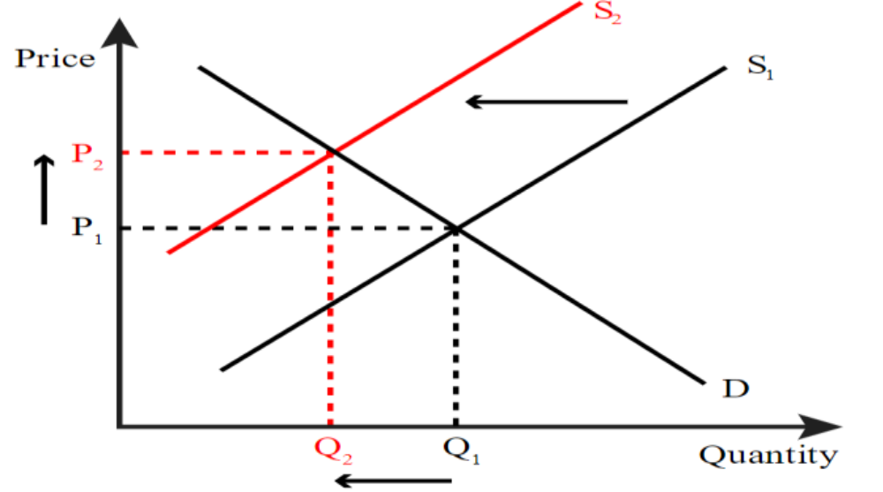
Decrease in Supply

Slide 30
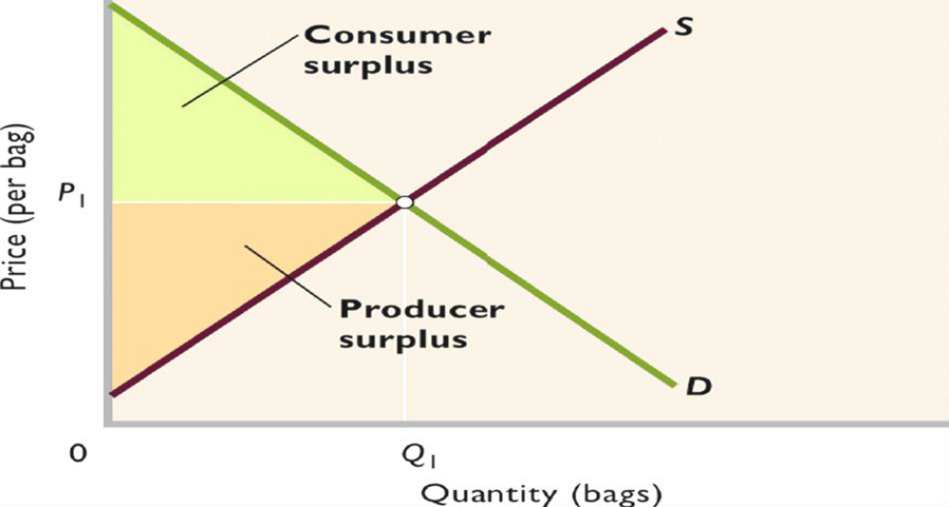
Consumer surplus & Producer surplus

Slide 31
Equilibrium Demand and Supply, Consumer Surplus and Producer surplus
Market equilibrium is the quantity-price point where supply and demand balance out in such a way that quantity demanded equals quantity supplied.
The market stabilizes at the price that corresponds to this quantity. When visualized on a graph, the economic equilibrium is the point of intersection between the demand and supply curves.
This point of intersection reflects the compromising quantity that both consumers are willing to seek out and producers are willing to supply at a certain price.

Slide 32
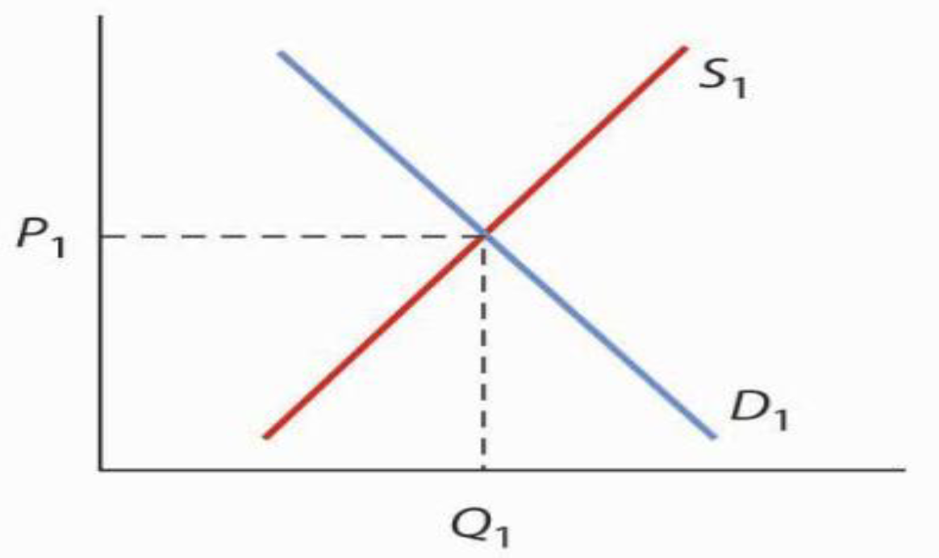
EQUILIBRIUM CURVE

Slide 33
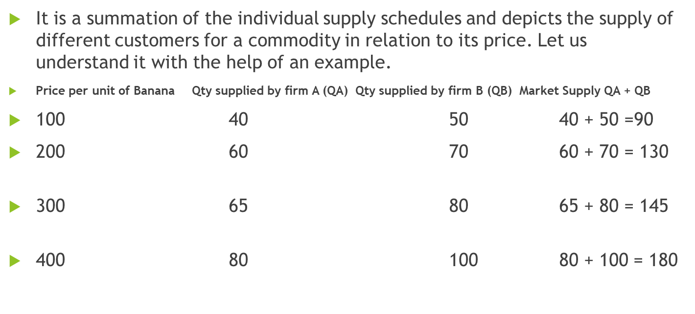
Market Supply Schedule

Slide 34
SURPLUS AND SHORTAGE
The specific ways in which the government, in a mixed economic system, can correct market failures of the market:
Legislation and regulation – the government can make laws that regulate market activity, for example, prohibit smoking in public (which would cause a negative externality). One important kind of legislation the govt. can undertake is price controls setting a minimum

Slide 35
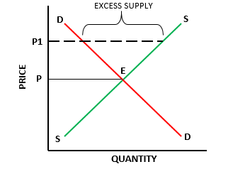
SURPLUS

Slide 36
Price Floor and Ceiling
Laws that government enacts to regulate prices are called Price controls. Price controls come in two flavors. A price ceiling keeps a price from rising above a certain level (the “ceiling”), while a price floor keeps a price from falling below a certain level (the “floor”).
Price ceiling: is a maximum price that can be charged for a product or service. A price ceiling is non-binding when it doesn't have an effect on the market price. A non-binding price ceiling occurs when the price level is greater than or equal to the market equilibrium price. For example, rent control and gasoline.
Price floor: is a minimum price at which a product or service is permitted to sell. A price floor is non-binding when it doesn't have an effect on the market price. A non-binding price floor occurs when the price level is less than or equal to the market equilibrium price. For example, agricultural products and minimum wage

Slide 37
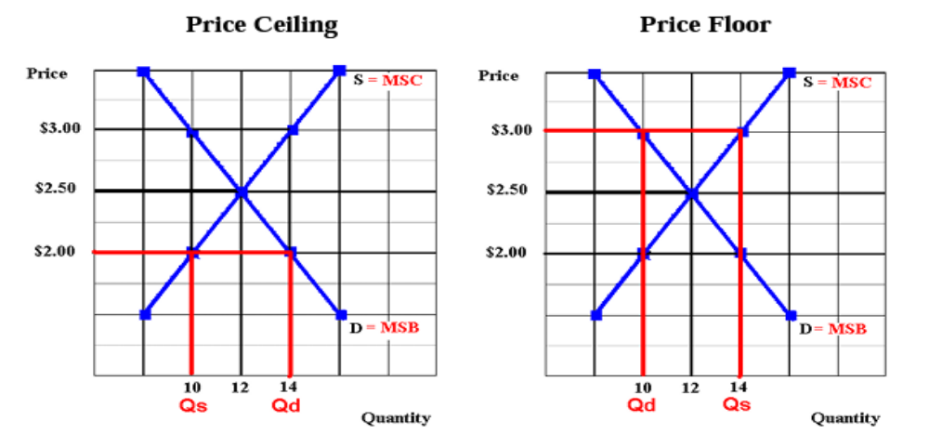
Price Ceiling & Price Floor

Slide 38
At Market Equilibrium
Price = $2.50 and Quantity = 12
The point is also the allocative efficient quantity because at Quantity = 12, Marginal Social Benefit = Marginal Social Cost
Price Ceiling
Ceiling Price = $ 2.00 Quantity Demand = 14 while Quantity Supply 10
Therefore, the shortage is equal to 4 and this shows that, there is an allocative inefficiency: at the quantity of 10, Marginal Social Benefit > Marginal Social Cost, so there is an under allocation of resources.

Slide 39
Price Floor
Floor Price = $ 3.00 Quantity Demand = 10 while Quantity Supply 14
Therefore, the surplus is equal to 4 and this shows that, there is an more efficiency: at the quantity of 14,
Marginal Social Benefit < Marginal Social Cost,
so there is an over allocation of resources.

Slide 40
MINIMUM PRICE OR PRICE FLOOR
Minimum price or price floor is set to control a decreasing tendency of price. The minimum wage laws in many countries are an example of minimum price.
The government sets the minimum wage above the existing market equilibrium wage, to ensure that all workers get a basic minimum wage to sustain them.
But even as low-income workers now get better wages, the higher wage will cause the demand for labour to contract, as shown in the diagram to the left.
There will also be higher supply of labour (workers who want work) because of higher wages.
A reduced demand and increased supply will cause excess supply of labour i.e., unemployment

Slide 41
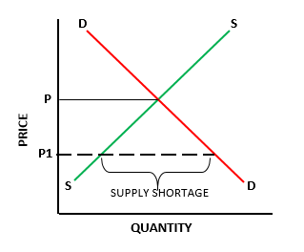
MINIMUM PRICE OR PRICE FLOOR-SHORTAGE

Slide 42
MAXIMUM PRICE OR PRICE CEILING
Maximum price or price ceiling is set to control an increasing tendency of price.
It is usually set on rent (this is called rent control), to ensure that low income tenants can afford to rent homes.
But as a result of the lower rent, landlord will stop renting more homes, causing supply to contract, as shown in the diagram to the left.
At the same time, lower rent will increase the demand for homes. A reduced supply of homes and higher demand for them will cause a shortage of supply in relation to demand.

Slide 43
KEY TAKE AWAYS on Equilibrium
The Market Equilibrium occurs at the intersection of the supply curve and the demand curve at point E in At this point, the quantity supplied (Q s ) by firms at a given price is equal to the quantity demanded (Q d ) by consumers at the same price.
Market Equilibrium = the point where the quantity supplied by producers at a given price is equal to the quantity demanded by consumers at that same price.
At point E (and only at point E), the following market equilibrium condition holds:
Q = Qs = Qd.

Slide 44
Cont…
Equilibrium Price = the price at which the quantity supplied equals the quantity
demanded.
The equilibrium price is also the Market Price , since it is the price determined in the market and agreed to by buyers and sellers.
Market Price = the price where quantity demanded is equal to quantity supplied.
The Equilibrium Quantity is Q, where the quantity supplied is identical to the quantity demanded.
Equilibrium Quantity = the point where quantity supplied is equal to quantity demanded.

Slide 45
Cont…
Any point other than point E is Disequilibrium point unsatisfactory to either buyers or sellers or both.
In disequilibrium, freely operating market forces come into play to cause the market to move toward the equilibrium point, E.
Disequilibrium = a market situation in which the market price does not equalize supply and demand.
Quick Quiz
How is the supply curve for wheat derived for an individual firm? For the industry?

Slide 46
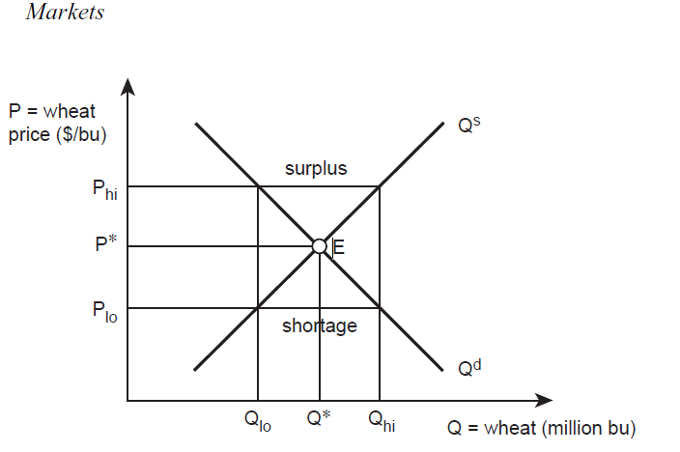
MARKET FORCES IN A WHEAT MARKET

Slide 47
DEMAND CURVE DERIVED
The demand curve for wheat (Qd ) shows the quantity of wheat that buyers will buy at each of a range of prices.
In the wheat market, the major consumers are millers who purchase wheat then grind it into the fl our used for baking bread or tortillas.
The demand curve for this wheat represents the consumers’ willingness and ability to pay for it.
Scarcity causes the demand curve to slope downward from left to right. As more wheat become available, millers offer lower prices to meet their needs for wheat.

Slide 48
GRAPH EXPLAINED
The price of wheat always gravitates toward the equilibrium point, E. Suppose that the price of wheat is Phi . At this relatively high price of wheat, the Law of Demand indicates that consumers (flour millers) will purchase only a small quantity of the grain.
Specifically, at price P hi , they will purchase Q lo million bushels of wheat. Wheat suppliers, however, expand wheat production when the price of wheat is high.
They will provide Q hi million bushels to the market when the price reaches P hi . At price P hi , the quantity supplied (Q hi ) exceeds the quantity demanded (Q lo ). This situation yields a Surplus , which is the horizontal distance between Q hi and Q lo

Slide 49
SURPLUS IN THE GRAPH EXPLAINED
Surplus = a market situation in which producers are willing to supply more of a good than consumers are willing to purchase at a given price
Qs > Qd .
A surplus occurs at any price higher than the equilibrium price (P*). In a surplus situation, there is more wheat available for sale than fl our millers are willing to purchase

Slide 50
SHORTAGE IN THE GRAPH EXPLAINED
If the price of wheat falls to P lo, wheat suppliers will cut back production to Q lo , and wheat
consumers (millers) will increase quantity demanded to Q hi . This situation results in a Shortage , since the quantity demanded (Q hi ) is greater than the quantity supplied (Q lo ). The shortage is the horizontal distance between Q lo and Q hi
Shortage = a market situation in which consumers are willing and able to purchase more of a good than producers are willing to supply at a given price (Qs < Qd ).

Slide 51
Mathematical models (optional)
Economics includes three ways to describe market phenomena: (1) graphs, (2) “stories,” or verbal explanations, and (3) mathematical models. The previous sections used graphs and stories to describe the market for wheat.
Simple algebra is another way to describe this market.

Slide 52
CALCULATIONS
The following equation represents the supply of wheat: where P is the price of wheat in dollars per bushel, and Qs is the quantity supplied of wheat in millions of bushels.
This equation is called an Inverse Supply Function , since price (the independent variable) is a function of quantity supplied (the dependent variable).
Mathematically, a supply function could be described as: Q s = f(P), since price is given and producers determine how much to produce given the independent variable, price. As before, price is measured along the vertical axis and quantity supplied is on the horizontal axis. Using the Inverse Supply Function , P = f(Qs ), makes a function easier to graph.
Inverse Supply Function = a supply function that is represented with price (the independent variable) as a function of quantity supplied (the dependent variable): P = f(Qs ).
Similarly, define an Inverse Demand Function as a demand function with the dependent variable (Q d ) and the independent variable (P) reversed:
P = 5 − 0.1Qd

Slide 53
EQUILIBRIUM CALCULATION
Inverse Demand Function = a demand function that is represented with price (the independent variable) as a function of quantity demanded (the dependent variable): P = f(Qd).
Suppose that is the inverse demand function for wheat:
P = 5-0.1Qd,
To find equilibrium, set the two equations equal to each other,
since P = P: 1 + 0.1Qs = 5 — 0.1Q .
Next, recall that in equilibrium, Q* = Q s = Q d , so replace the quantities supplied and demanded with the equilibrium quantity: 1 + 0.1Q* = 5-0.1Q*.

Slide 54
EQUILIBRIUM CALCULATION
Now subtract one from each side of the equation, and add 0.1Q* to each side of the equation to get: 0.2Q* = 4, or Q* = 20 million bushels of wheat.
Substituting this equilibrium quantity (Q*) into the inverse supply function yields the equilibrium price:
P = 1 + 0.1Qs =1 + 0.1(20 ) = 1 + 2 = $3/bu of wheat.
Check this result by plugging the equilibrium quantity into the inverse demand equation:
P = 5-0.1Qd = 5 -0.1(20) = 5 - 2 = $3/bu of wheat.

Slide 55
EXPLAINATION
A model such as this helps an analyst determine the implications of how a change in the price of wheat will affect the wheat market. For example, suppose that the price of wheat increases to a level above the equilibrium level to $4/bu.
Both the graph and the mathematical model provide information telling that a price above the equilibrium level will increase production, decrease consumption, and result in a surplus.
To calculate the levels of quantity supplied and demanded, simply plug in the price of $4/bu into the inverse supply and inverse demand equations:
4 = 1 + 0.1Qs

Slide 56
Cont…
3 = 0.1Qs
Qs = 30, divide both sides by o.1
Qs = 30 million bushels of wheat,
1 = 0.1Qd Divide both sides by 0.1
Qd = 10 million bushels of wheat.
The surplus quantity (Q s - Q d ) can also be calculated:
Surplus (Qs - Qd) = 30 – 10 = 20 million bushels of wheat.
This procedure also helps calculate a below-equilibrium price that leads to a shortage.
Suppose that the price of wheat drops to $2/bu. The inverse supply and inverse demand
equations yield the following estimates of quantities:
2 = 1 + 0.1Qs
1 = 0.1Qs

Slide 57
Cont…
This procedure also helps calculate a below-equilibrium price that leads to a shortage. Suppose that the price of wheat drops to $2/bu. The inverse supply and inverse demand equations yield the following estimates of quantities:
2 = 1 + 0.1Qs
1 = 0.1Qs
Qs = 10 million bushels of wheat,

Slide 58
Shortage calculation
2 = 5 – 0.1Qd
3 = 0.1Qd
Qd = 30 million bushels of wheat.
The shortage quantity (Q d - Q s ) can also be calculated:
Shortage = (Qd - Q s ) = 30 - 10 = 20 million bushels of wheat.
This procedure also helps calculate changes in supply or demand brought about by economic variables.

Slide 59
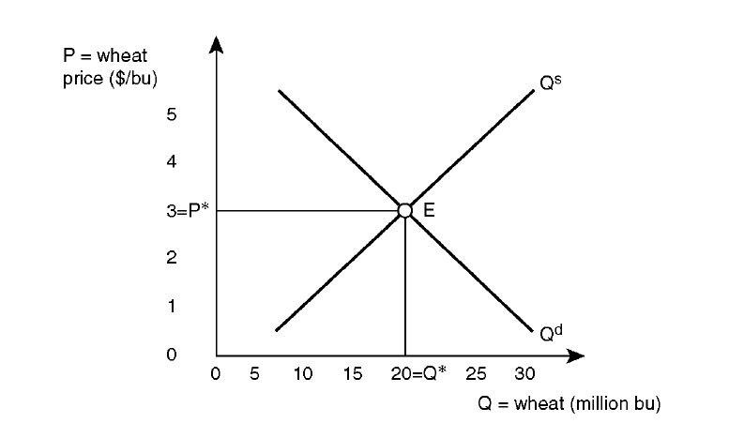
GRAPHICALLY

Slide 60
Direct provision of merit and public goods
Direct provision of merit and public goods – since there is little incentive for the price mechanism to supply these goods, governments usually provide them.
For example, free education, free healthcare, public parks. One way the govt. can do this is by nationalising certain products it considers essential to be provided by a governing authority, rather than the market.
For example, in Zambia, the government operates the only railway network because only it can provide cheap services to its millions of poor, daily passengers.

Slide 61
TAXATION ON PRODUCTS
Taxation on Natural Resource products – imposing a tax on products (indirect taxes) with negative externalities can discourage its production and consumption.
For example, a tax on tobacco will make it expensive to produce and consume.
In the diagram below, a tax has been imposed on a product, causing its supply to shift from S to S1. The price rises from P to P1 because of the additional tax amount, and the quantity traded in the market falls from Q to Q1.

Slide 62
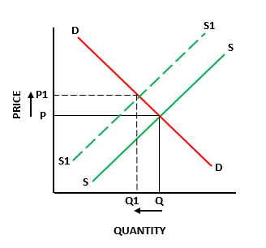
TAXATION ON PRODUCTS

Slide 63
SUBSIDIES
Subsidies – a subsidy is a grant (financial aid) on products that have a positive externality.
Subsidising, for example, cooking gas for the poor, will increase the living standard of the population.
In the diagram below, a subsidy has been imposed on a good, causing its supply to shift from S to S1.
It results in a fall in price from P to P1 and subsequently, an increase in the quantity traded in the market from Q to Q1

Slide 64
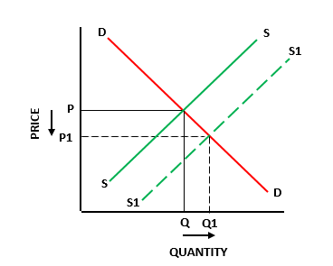
SUBSIDIES
Notes:
Note: movements along a demand or supply curve of a good only happen as a result of a direct change in price of the good; changes caused by any other factor, tax and subsidy included, is represented by a shift in the curves

Slide 65
LEGISLATION AND REGULATION
Tradable permits – firms will have to buy permits from the government to do something, for example, pollute at a certain level, and these can be traded among firms. Since permits require money, firms will be encouraged to pollute less.
Extension of property rights – one of the main reasons for pollution in public spaces is that it is public – it does not harm a specific private individual – the resource is the governments who cannot charge compensations easily. So the government can extend property rights (right to own property) of public places to private individuals. This will effectively privatize resources, create a market for these spaces and then individuals can be fined for polluting
International cooperation among governments – governments work together on issues that affect the future of the environment.

Slide 66
DRAWBACKS TO GOVERNMENT INTERVENTION IN AN ECONOMY
Political incentives: this occurs when there is a clash between political and economics (because a government is a political entity with political incentives).
For example, even though mining companies cause a lot of environmental damage, the government may encourage and promote their activities to garner political and financial support from them.
Lack of incentives: in the free market, individuals have a profit incentive to innovate and cut costs, but in the public sector, such an incentive is absent since the government will pay them salaries regardless of their performance.
So, even as the government provides certain public and merit goods directly to the people at low costs, they tend to be very inefficient

Slide 67
DRAWBACKS TO GOVERNMENT INTERVENTION IN AN ECONOMY
Time lags, information failure: these are some of the government failure arising because of a lack of incentive.
Government offices and employees don’t have an incentive to provide timely services or give accurate information and this leads to very inefficient systems.
Welfare effects of policies: government policies such as taxation and welfare payments distort the market. This means that such policies will influence demand and supply in the
Economy and cause markets to move away from the efficient points produced by a market system. For example, high corporate taxes will deter companies from expanding their operations and making more profits or deter new enterprises from entering the market.
Unemployment benefits given out by the government may cause people to stay unemployed and receive free benefits instead of working.

Slide 68
DEFINITION OF ELASTICITY OF DEMAND: ALFRED MARSHAALL
According to him “the elasticity (or responsiveness) of demand in a market is great or small according as the amount demanded increases much or little for a given fall in price, and diminishes much or little for a given rise in price”.

Slide 69
FACTORS DETERMINING THE PRICE ELASTICITY OF DEMAND
1. Availability of Substitute: Goods having close substitutes will have an elastic demand and goods with no close substitutes will have an inelastic demand. Commodities such as Pen, Pepsi, Maruti car have close substitutes and hence have an elastic demand.
2. Income of the consumers: If the income level of consumers is high, the elasticity of demand will be less. It is because change in the price will not affect the quantity demanded by greater proportion
3. Luxuries versus Necessities: The price elasticity of demand is likely to be low for necessities and high for luxuries
4. Number of uses of the commodity: The more the number of uses of a commodity has more elastic demand. If a commodity has few uses it has an inelastic demand.
5. Cost relative to total income: higher the cost of the goods relative to total income of consumer more will be the price elasticity demand.
6. Level of price: if the price of the commodity is high the price elasticity of demand is more and if it is low, its price elasticity of demand is less.

Slide 70
TYPES OF ELASTICITY OF DEMAND
Price Elasticity of Demand
Income Elasticity of Demand
Cross Elasticity of Demand
Advertising elasticity of Demand
Elasticity of Price Expectations

Slide 71
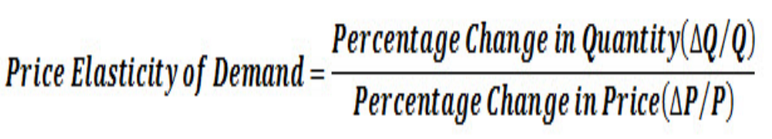
PRICE ELASTICITY OF DEMAND
“The degree of responsiveness of quantity demanded to a change in price is called price elasticity of demand

Slide 72
DIFFERENT TYPES OF PRICE ELASTICITY OF DEMAND
1. PERFECTLY INELASTIC DEMAND (EP = 0):
Description: when to a percentage change in price there is no change in quantity demanded.
Types of Goods: Essentials like life saving goods
Changes in price yield no change in demand

Slide 73
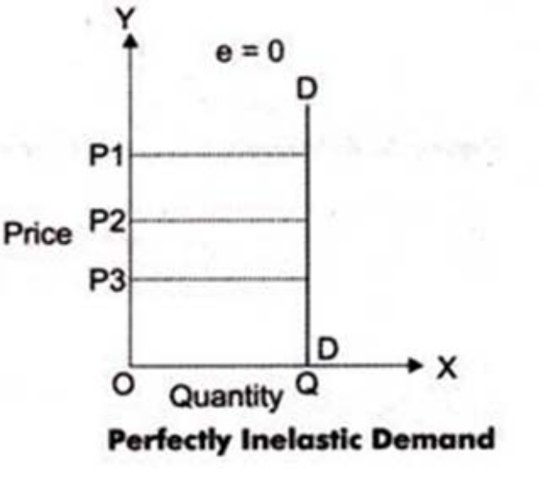
Shape of Demand curve: Vertical

Slide 74
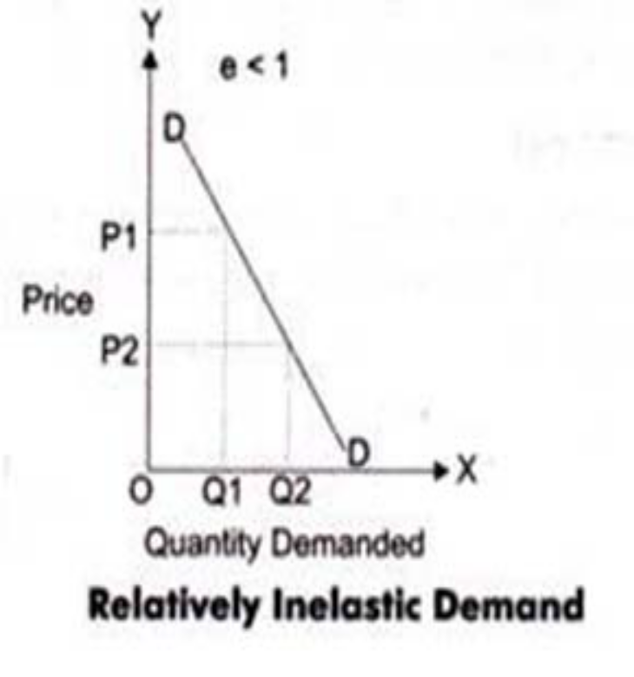
2. RELATIVELY INELASTIC DEMAND (EP< 1 )
Description: when to a percentage change in price there is less than proportionate change in quantity demanded.
Types of Goods: Necessities like food, fuel
Shape of Demand curve: Steeper
Changes in price yield an insignificant change in demand

Slide 75
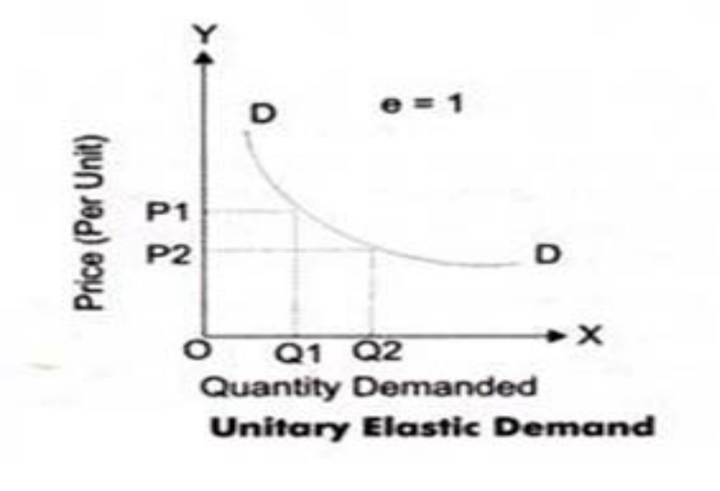
3. UNITARY ELASTIC DEMAND ( EP = 1)
Description: when to a percentage change in price there is equal change in quantity demanded.
Types of Goods: Normal goods
Shape of Demand curve: the linear demand curve forming 45o angle both the axes
Changes in price yield equivalent (%) changes in demand

Slide 76
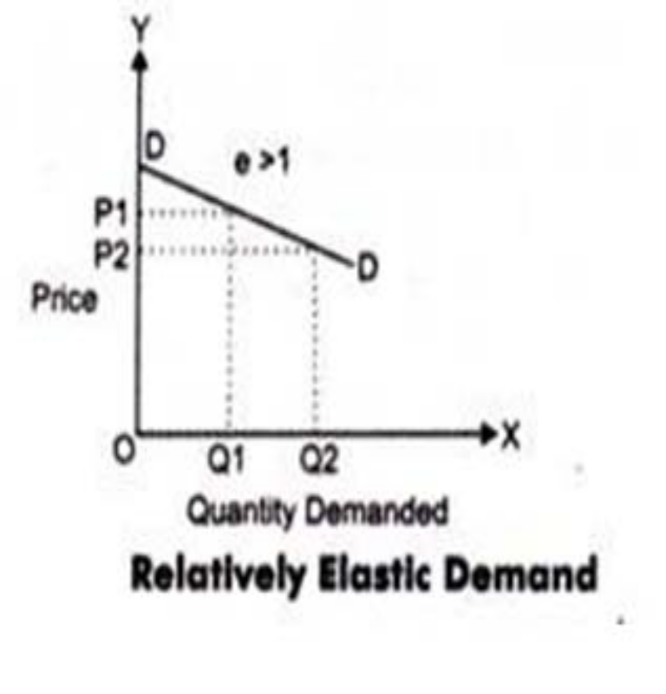
4. RELATIVELY ELASTIC DEMAND (EP> 1)
Description: when to a percentage change in price there is more than proportionate change in quantity demanded.
Types of Goods: Luxuries
Shape of Demand curve: Flatter
Changes in price yield a significant change in demand

Slide 77
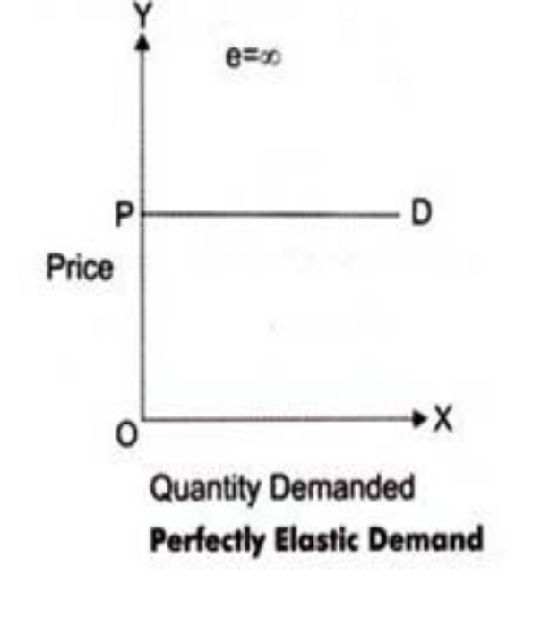
5. PERFECTLY ELASTIC DEMAND (EP = ∞)
Description: when there is infinite change in quantity situation demanded without any changes in price
Types of Goods: Imaginary
Shape of Demand curve: Horizontal
Changes in price result in demand declining to zero

Slide 78
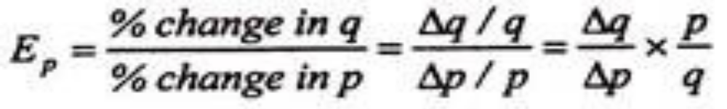
METHODS OF CALCULATING PRICE ELASTICITY OF DEMAND
1. The Percentage Method:
The price elasticity of demand is measured by its coefficient (Ep). This coefficient (Ep) measures the percentage change in the quantity of a commodity demanded resulting from a given percentage change in its price. Where q refers to quantity demanded, p to price and Δ to change.
If EP>1, demand is elastic. If EP< 1, demand is inelastic, and Ep= 1, demand is unitary elastic.

Slide 79
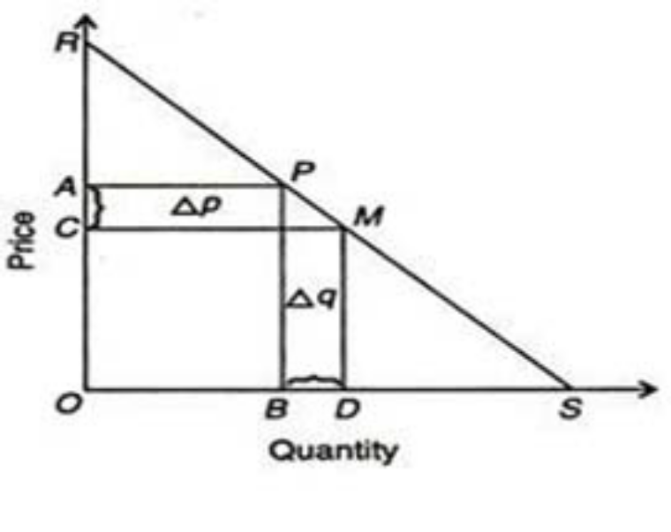
The Point Method or Geometrical or graphical method
The point method of measuring elasticity of demand was developed by Alfred Marshall. Elasticity measures at a point on a demand curve is known as point elasticity of demand
Let RS be a straight line demand curve in Figure. If the price falls from PB ( = OA) to MD ( = OC), the quantity demanded increases from OB to OD.

Slide 80
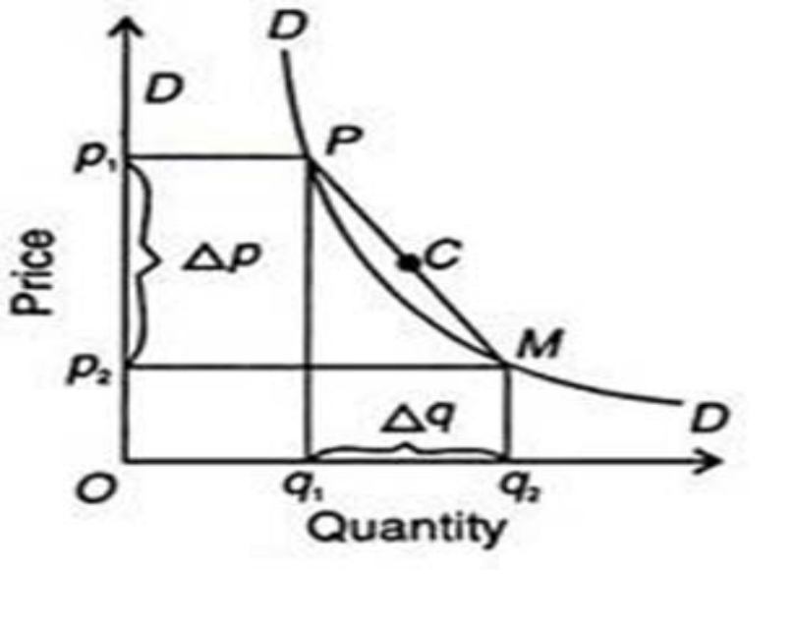
3. The Arc Method:
When elasticity of demand is measured over a finite range or ‘arc’ of a demand curve, it is called arc elasticity of demand. when elasticity is measured between two points on the same demand curve, it is known as arc elasticity.

Slide 81
CONT.…
The area between P and M on the DD curve in Figure is an arc which measures elasticity over a certain range of price and quantities.
Elasticity for the arc (PM in Figure ) is calculated by taking the average of the two prices [(p1 + p2 )½] and the average of the two quantities [(q, +q2 )½].
The formula for price elasticity of demand at the mid-point (C in Figure 4) of the arc on the demand curve.

Slide 82
The Total Outlay Method:
Marshall evolved the total outlay, or total revenue or total expenditure method as a measure of elasticity. By comparing the total expenditure of a purchaser both before and after the change in price, it can be known whether his demand for a good is elastic, unity or less elastic.
Total outlay is price multiplied by the quantity of a good purchased: Total Outlay = Price x Quantity Demanded.

Slide 83
EXAMPLES
A dealer in deep freezers increased the price of his products from K450 to K500.
And his sales dropped from 800 units to 600 units,
Use the information above to answer the questions below:
A) Calculate the price elasticity of demand
B) What type of elasticity is this?
C) Was the decision to increase price Okay for the business? Why?
P1=K450, P2 = K500, Change in P, =50
Q1 = 800 units, Q2 = 600 units Change in Q = -200 units
Ep = (Change in Q)/Q x P/(Change in P) = -200/800 x 450/50 = -2.25

Slide 84
CONT….
Or % Change in Qd /% Change in P = [((600-800)/800)x100]/[((500-450)/450)x100] = 25% /11.1% = 2.25
The elasticity is Relative Elastic demand
Q2. Calculate the arc elasticity using the data below
P1 = K1000, P2 = 800 Q1 = 200 UNITS , Q2 = 300 UNITS
Pe = [(Q2 – Q1)/9(Q1+Q2)/2] / [(P2-P1)/(P1+P2)/2]
Pe = - 1.8

Slide 85
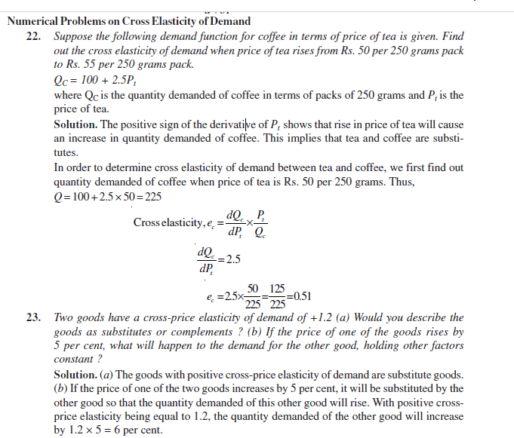
EXAMPLE ON CROSS ELASTICITY

Slide 86
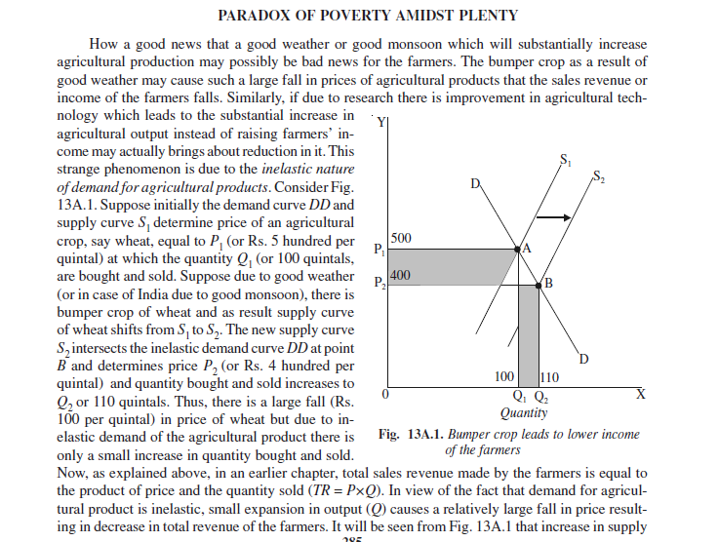
Application Of Elasticity Of Demand
The Paradox of Poverty Amidst Plenty

Slide 87
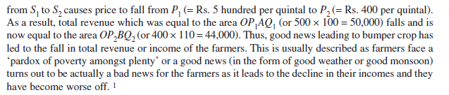
Application Of Elasticity Of Demand
The Paradox of Poverty Amidst Plenty

Slide 88
EXAMPLES
Consider the demand equation Q = 80 - 10P. Calculate the point-price elasticity of demand (ep) and total revenue (TR) for P = 0 to P = 8.
By definition ep = (dQ/dP)(P/Q) and TR = P \ Q. The solution values are summarized in Table
When the price of the commodity is $6, the quantity demanded is 20 units. Total revenue is $120. The price elasticity of demand at the price–quantity

Slide 89
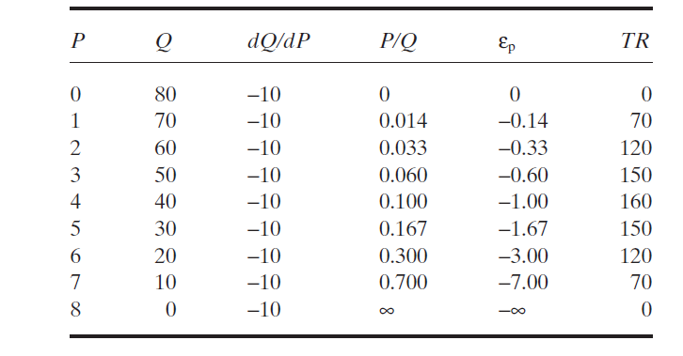
TABLE OF SOLUTION

Slide 90
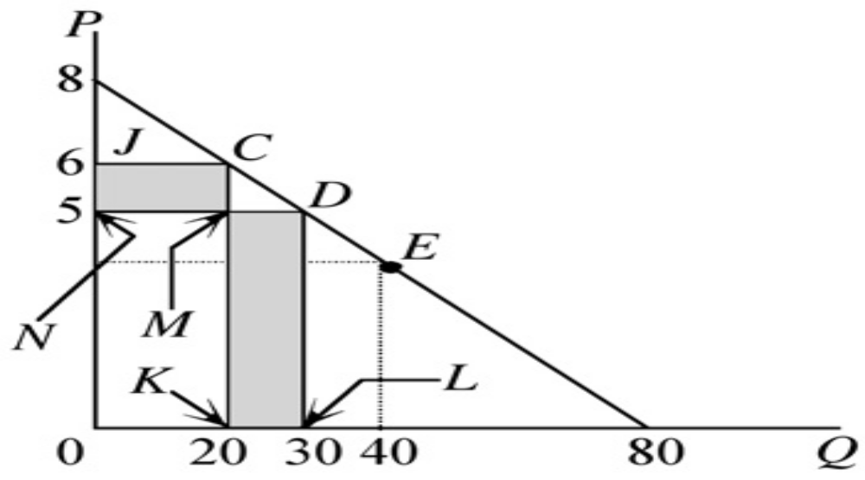
GRAPHICAL REPRESENTATION
Price-elastic demand: a decrease (increase) in price and an increase (decrease) in total revenue.

Slide 91
EXPLAINATION
Combination is –3.00; that is, a 1% decline in price instantaneously will result in 3% increase in the quantity demanded.
When the price is lowered to $5, the quantity demanded increases to 30 units.
The price elasticity of demand at that price–quantity combination is -1.67.
Intuitively, since the quantity demanded for this product is price elastic within this range of values, we would expect an increase in total expenditures (revenues) for this product as the price declines from $6 to $5, and that is exactly what happens.
As the price declines from $6 to $5, total revenues earned by the firm rises from $120

Slide 92
CONT…
To $150. The fact that total revenues increased following a decrease in price in the elastic region of the demand curve (above the midpoint E can be seen by comparing the rectangles 0JCK and 0NMK which represent total revenue (TR = P \ Q) at P = $6 and P = $5, respectively. Note that both rectangles share the area of the rectangle 0NMK in common.
When the price declines from $6 to $5, total expenditures decline by the area of the rectangle NJCM = -$1(20) = -$20. This is not the end of the story, however. As a result of the price decline, the quantity demanded increases by 10 units, or an offsetting increase in revenue equal to the area of the rectangle KMDL = $5(10) = $50, or a net increase in total revenue of KMDL + NJCM = $50 - $20 = $30.

Slide 93
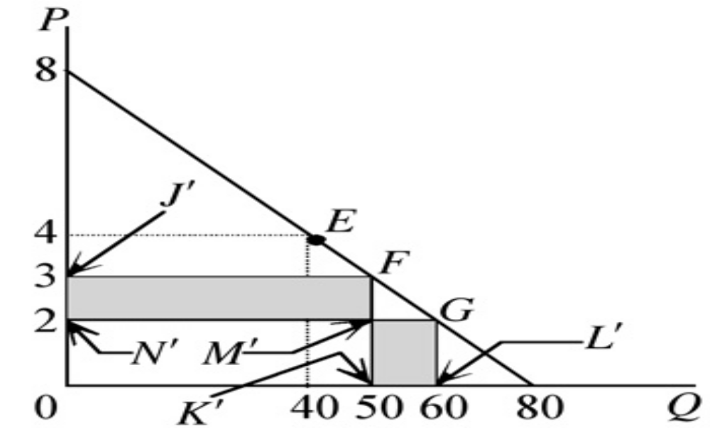
Price-inelastic demand: a decrease (increase) in price and a decrease (increase) in total revenue.

Slide 94
INELASTIC CASE
Suppose, on the other hand, that the price declined in the inelastic region of the demand curve. At P = $3 the quantity demanded is 50 units, for total expenditures of $150. This is shown in Figure 4.11 as the area of the rectangle 0J￠FK￠.We saw in the Table above that at P = $3, Q = 50, |ep| = 0.60, and TR = $150.
When price falls to $2, the quantity demanded increased to 60 units, |ep| = 0.33, and TR = $120.
In other words, when the price is lowered in the inelastic region of a demand curve then total revenue falls

Slide 95
CONT…
The fact that total revenues (expenditures) fall as the price declines in the inelastic region of the demand curve can also be illustrated diagrammatically.
As the price declines from $3 to $2 total revenues decline by the area of the rectangle N’J’FM’ = -$1(50) = -$50.
As a result of this price decline, however, the quantity demanded increases by 10 units, or an offsetting increase in total revenue equal to the area of the rectangle K’M’GL’ = $2(10) = $20, or a net decrease in total revenue of K’M’GL’ – N’J’FM’ = $20 - $50 = -$30.

Slide 96
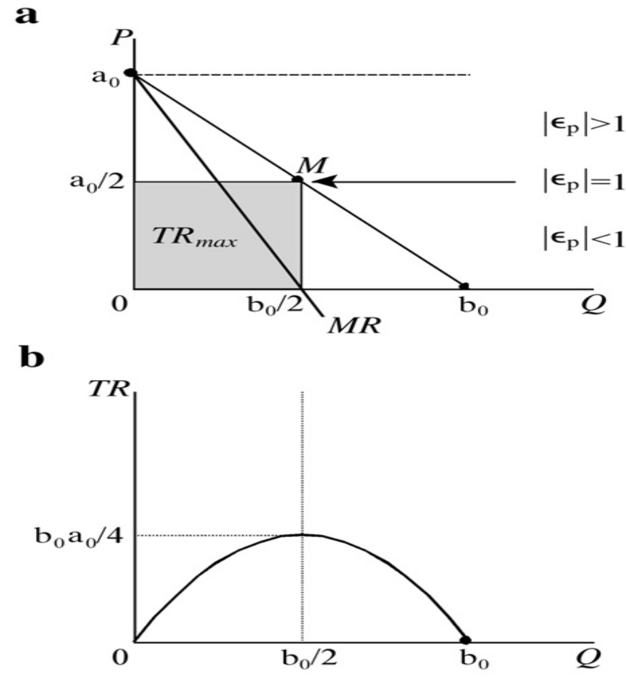
Price elasticity of demand and total revenue.

Slide 97
EXPLAINATION
As the selling price of the commodity is lowered in the elastic region of the demand curve, the quantity demanded increases and total revenue rises.
As the selling price is lowered in the inelastic region of the demand curve, the quantity demanded increases, although total revenue falls.
Similarly, as the selling price of the product is increased in the inelastic region of the demand curve, the quantity demanded falls and total revenue increases.
As the selling price is increased in the elastic region of the demand curve, quantity demanded falls, as does total revenue.

Slide 98
FORMAL RELATIONSHIP BETWEEN THE PRICE ELASTICITY OF DEMAND AND TOTAL REVENUE
The relationship between the price elasticity of demand (ep) and total revenue (TR) may be demonstrated by using elementary differential calculus.
To begin with, consider again the general form of the demand function
Q = f (P)
Where; dQ/dP < 0
In other words, the quantity demanded of a product is negatively related to the selling price.Total revenue is defined as price P times quantity Q, or TR = PQ

Slide 99
Differentiating TR with respect to Q, and utilizing the inverse-function rule it is possible to write the inverse of the demand function
P = g(Q). Where dP/dQ < 0. We use the product rule to find the appropriate first-order condition for total revenue maximization:

Slide 100
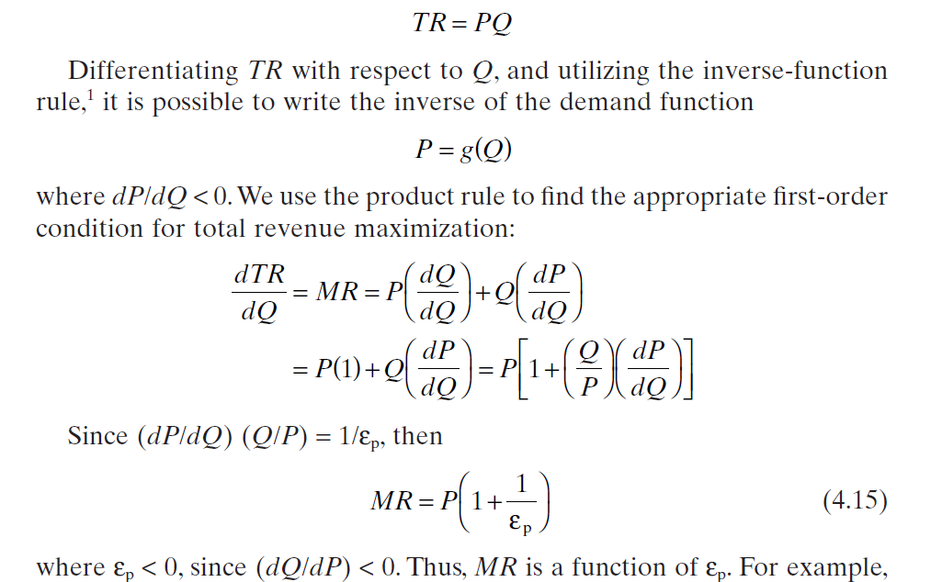
Equations

Slide 101
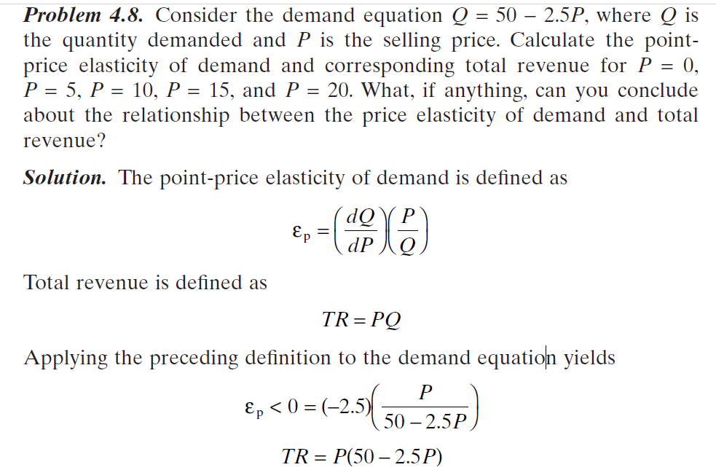
EXAMPLES

Slide 102
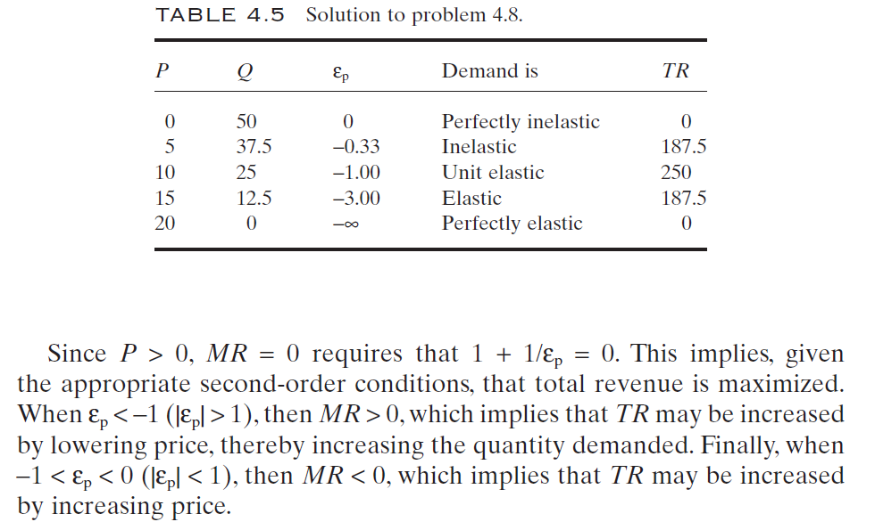
SOLUTIONS

Slide 103
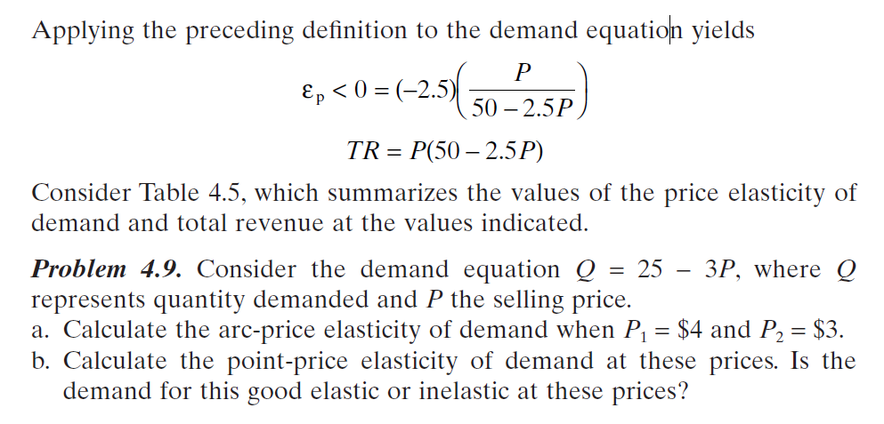
CONT…

Slide 104
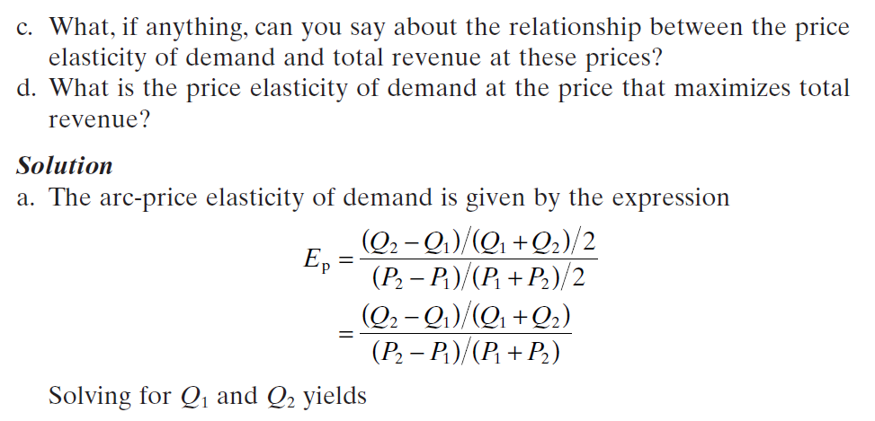
CONT…

Slide 105
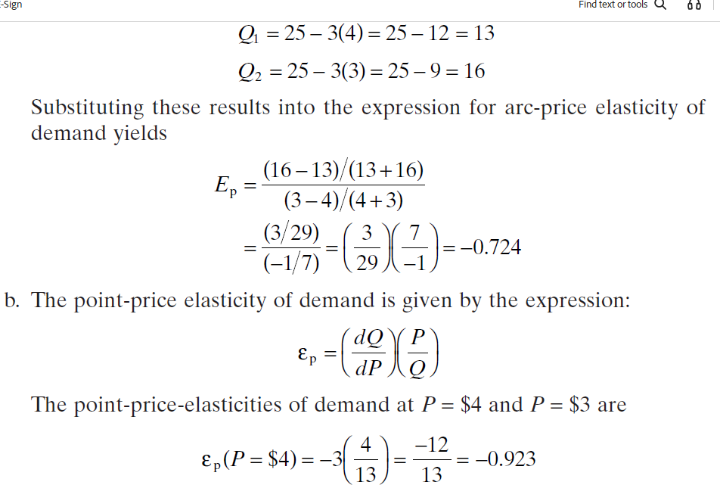
CONT…

Slide 106
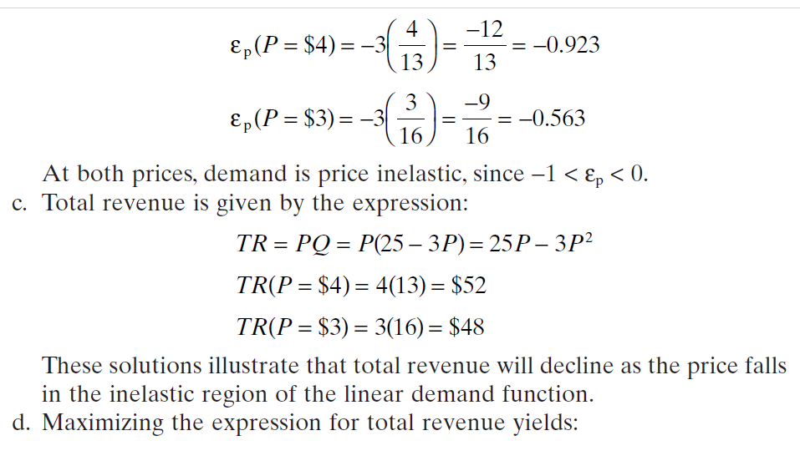
CONT…

Slide 107
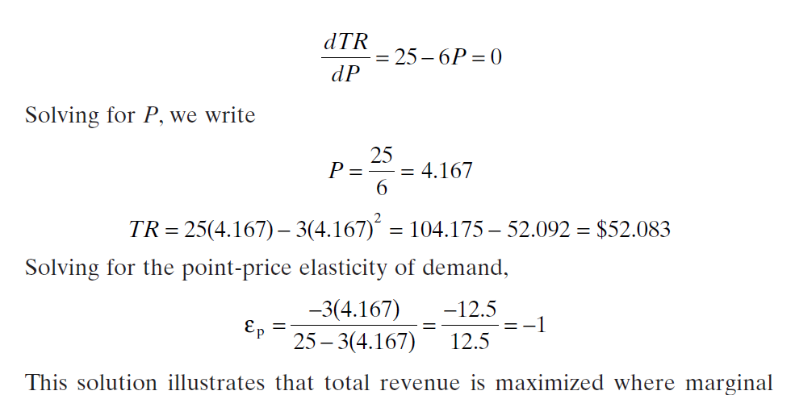
CONT…

Slide 108
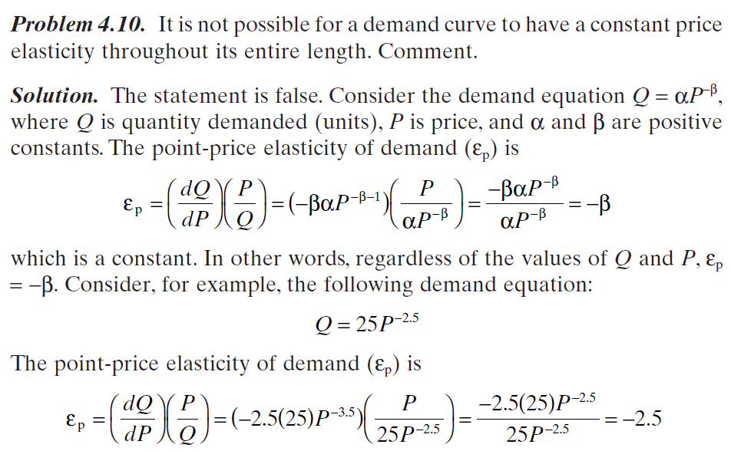
CONT…

Slide 109
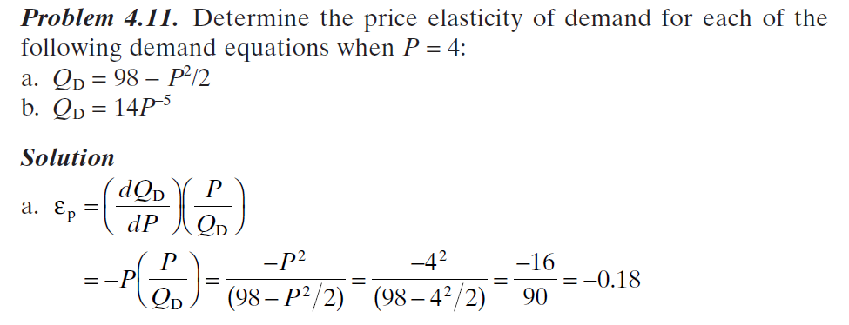
CONT…

Slide 110
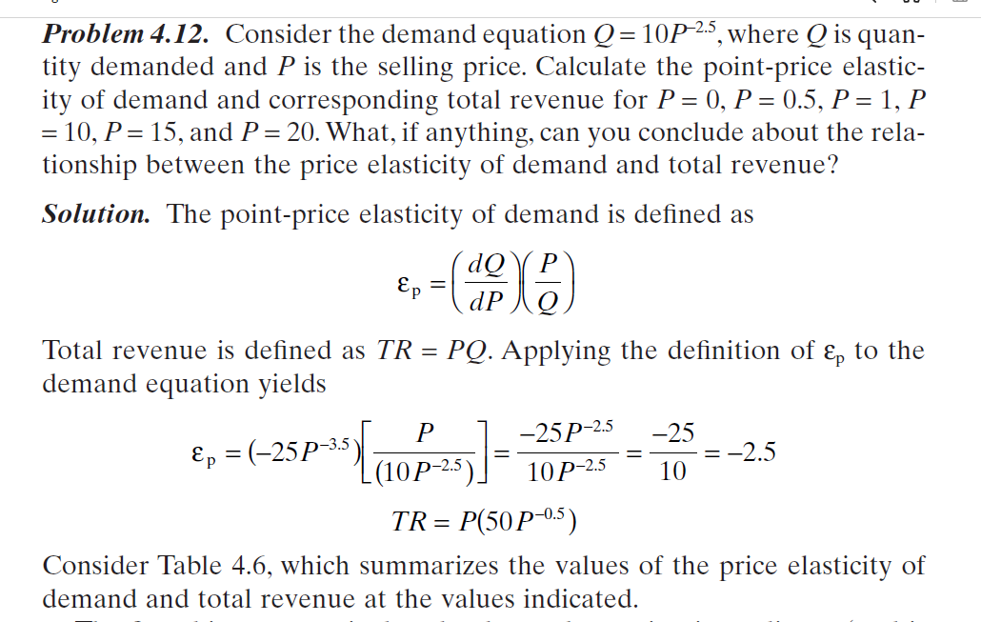
CONT…

Slide 111
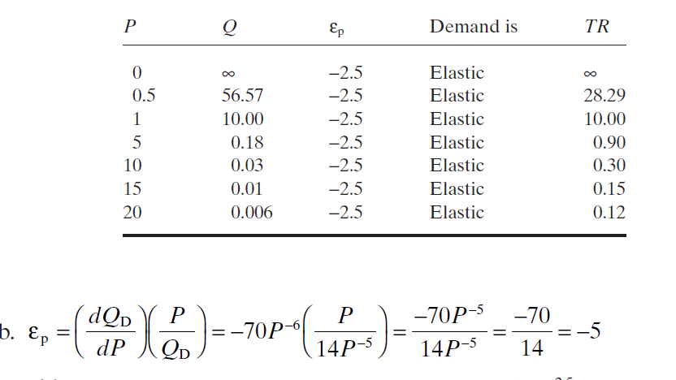
TABLE 4.6 SUMMARY SOLUTION FOR Q4.12

